Slide 1
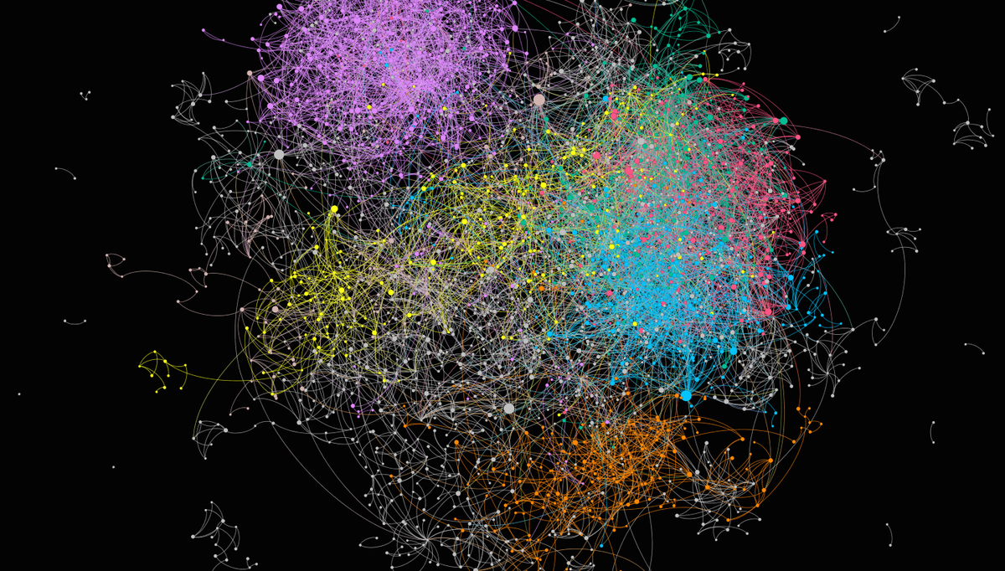



Network Embedding for Role Discovery:
Concepts, Tools, and Applications
Mark Heimann, Junchen Jin, Danai Koutra
SIAM International Conference on Data Mining– April 30, 2022
Notes:
Hi everyone. I’m Junchen Jin, a research assistant at the Graph Exploration and Mining at Scale Lab at the University of Michigan Ann Arbor. Today I’m honored to present our work “Understanding and Evaluating Structural Node Embeddings”. Special thanks to our team Mark Heimann and Di Jin, and our supervisor Prof. Danai Koutra.

Slide 2



About the tutorial organizers
Mark Heimann Junchen Jin Danai Koutra
LLNL Northwestern University University of Michigan,
Amazon

Slide 3
Tutorial Goal
This tutorial aims to provide an (incomplete) overview of
the major structural or role-based node embedding methods, and connect them to role equivalence research in mathematical sociology.
Expectations:
Familiarity with graphs and representation learning.
We’ll provide a high-level introduction and relevant definitions.

Slide 4
Tutorial Outline:
Network Embedding for Role Discovery
Part I: Lecture
  Introduction
  Structural roles in
    network science
    mathematical sociology
  Structural or role-based embedding methods
  Mining structural roles within a network
  Mining structural roles across networks
Part II: Demo
  Hands-on demo

Slide 5
Tutorial Outline:
Network Embedding for Role Discovery
Part I: Lecture
  Introduction
  Structural roles in
    network science
    mathematical sociology
  Structural or role-based embedding methods
  Mining structural roles within a network
  Mining structural roles across networks
Part II: Demo
  Hands-on demo

Slide 6
Tutorial Outline:
Network Embedding for Role Discovery
Part I: Lecture
  Introduction
  Structural roles in
    network science
    mathematical sociology
  Structural or role-based embedding methods
  Mining structural roles within a network
  Mining structural roles across networks
Part II: Demo
  Hands-on demo

Slide 7
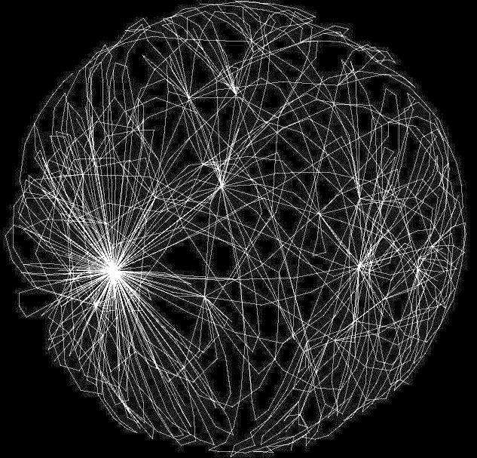
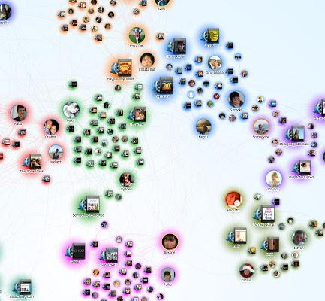
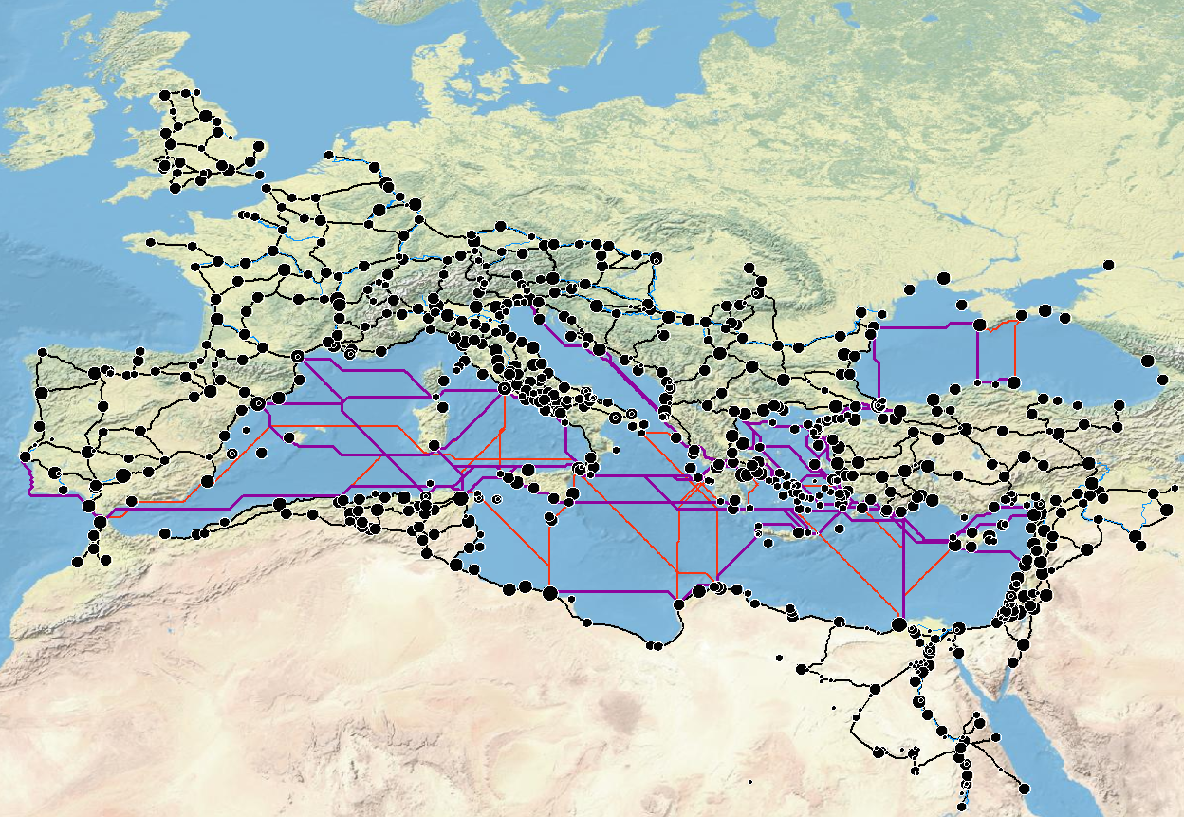
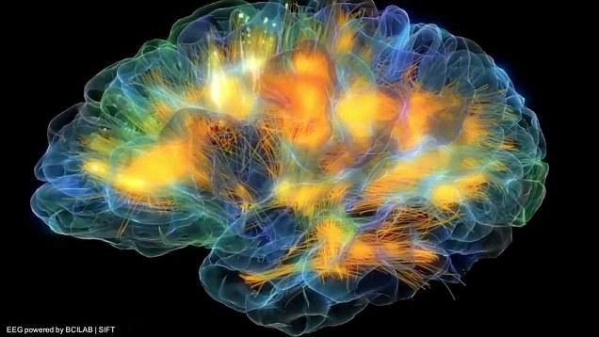


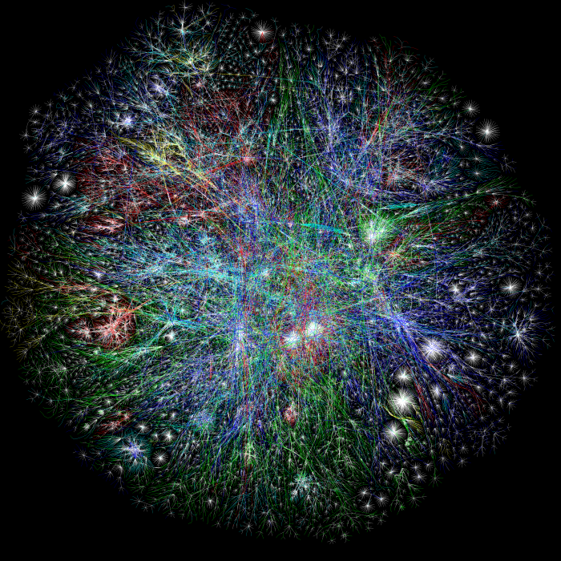

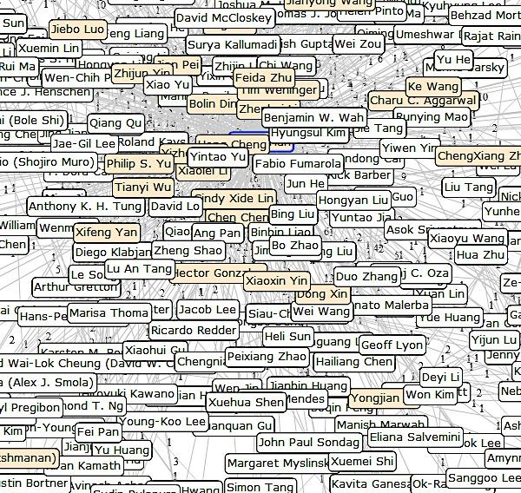

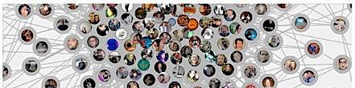
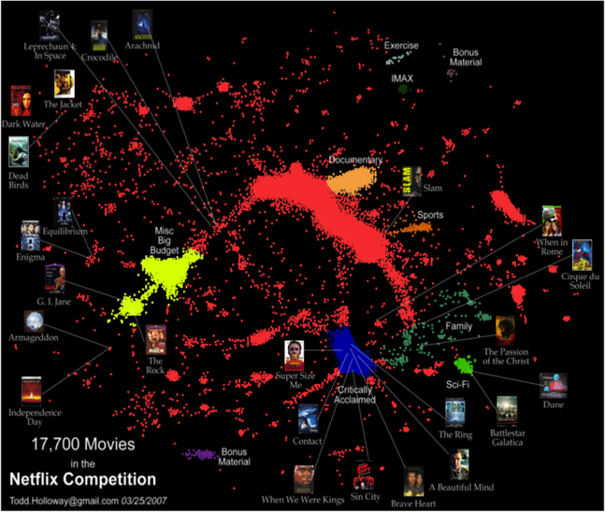

Networks Are Everywhere
dblp

Slide 8
Networks: The Basics
Graph (or network)
G = (V, E⊆V²)
Adjacency matrix A
Nodes
4
1 2 3 4
1
2
3
4
0 1 1 1
edge between nodes 1 and 2
(and 2,1 since graph is undirected)
1
Nodes
1 0 1 0
1 1 0 0
3
1 0 0 0
2

Slide 9
Node Degree
Number of neighbors or connections
Most basic, simple to compute
Highly descriptive of structural role
4
degree deg(v₁) = 3
1
3
2

Slide 10

(Local) Clustering Coefficient
Proportion of triangles in neighborhood
Tells how clique-like the node’s neighborhood is
# of triangles in u’s neighborhood
4
CC(v₁) = ⅓
1 triangle (1-2-3) out of 3 possible: (1-2-3, 1-2-4, 1-3-4)
1
3
2
# of possible triangles

Slide 11
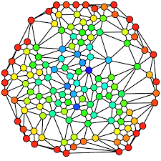

Betweenness Centrality
Portion of shortest paths going through node
Measures the “monitoring” role of the node
High centrality means the node is essential for passing information through the network
More global, also more expensive to compute
Notes:
SP(i,j;u) shortest paths from node i to node j going through node u
cubic in the number of nodes

Slide 12

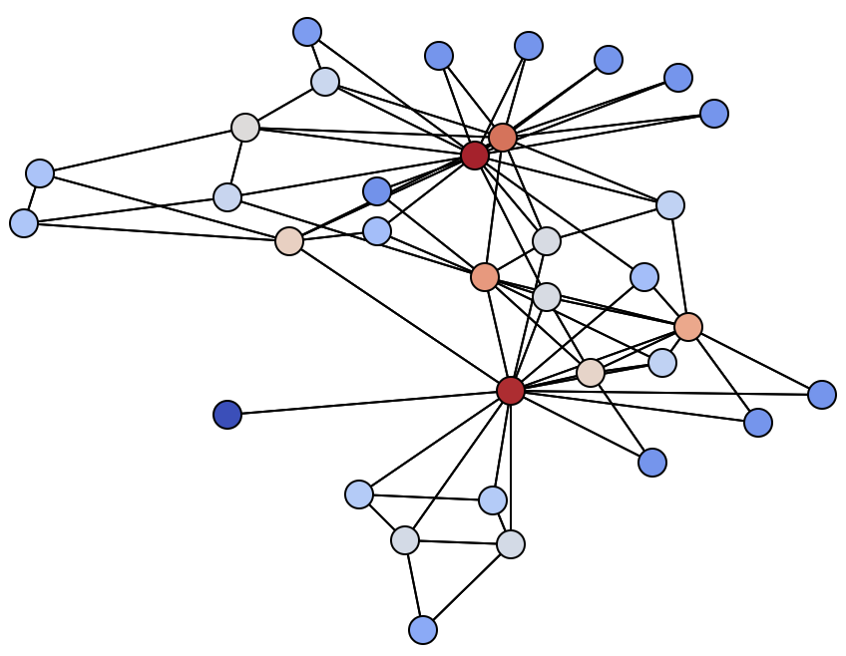

PageRank
Iterative computation of influence/importance scores
More influential nodes are linked to by other influential nodes
Links count more the fewer of them a node sends out
with prob δ
follow a link at random
with prob 1-δ
teleport to a random node
Notes:
PageRank update equation at time t
Damping factor δ

Slide 13
Tutorial Outline
Part I: Lecture
  Introduction
  Structural roles in
    network science
    mathematical sociology
  Structural or role-based embedding methods
  Mining structural roles within a network
  Mining structural roles across networks
Part II: Demo
  Hands-on demo

Slide 14
Which Parts of a Network are Similar?
Similarity based on node connectivity
Indirect as well as direct!
As opposed to high disconnection
Notes:
Direct connections, or indirect connections, often mean more similarity than disconnection

Slide 15

What Can We Learn from Network Similarity?
POV: this network models a company’s internal communication
Engineering
Sales
Notes:
Example: proximity might discover different divisions within a company
engineering vs. sales departments

Slide 16
Which Parts of a Network are Similar?
Similar patterns of connectivity
Which may not be true of nodes that are connected!
Notes:
Direct connections, or indirect connections, often mean more similarity than disconnection

Slide 17
What Can We Learn from Network Similarity?
POV: this network models a company’s internal communication
Engineering
Sales
Worker
Manager
Worker
Manager
Worker
Worker
Notes:
Example: proximity might discover different divisions within a company or industry, while network structural roles might reflect professional roles that are common across divisions or industries

Slide 18
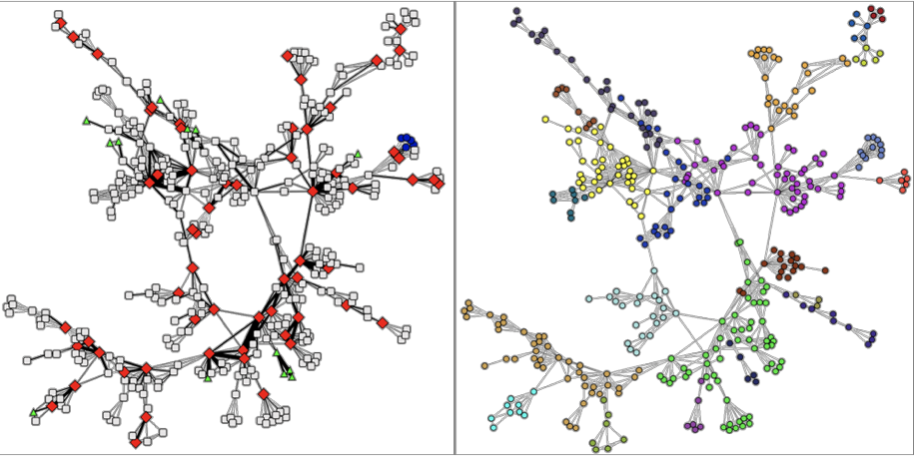

Structural Similarity vs. Proximity
[Henderson+ ‘12]
Structural Similarity
Proximity
Find similarity between nodes all over the network with similar roles
Useful for role-based classification
Can be compared across networks
Find similarity only between nodes in the same part of the network
Useful for link prediction, classification when labels exhibit homophily
[Jin+ ‘21]
[Grover+ ‘16; Perozzi+ ‘14]
[Rossi+ ‘21]
Notes:
Let’s illustrate node similarity.
Structural similarity finds the similarity between nodes all over the network with similar roles. For example, in this network, the red nodes all have a hub role.
Proximity finds similarity only between nodes in the same part of the network. Again, in this network, nodes’ colors reflect their community.

Slide 19
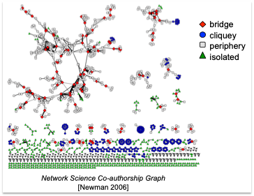
What are roles?
The ways in which nodes / entities / actors relate to each other
“The behavior expected of a node occupying a specific position” [Homans ‘67]
  e.g., centers of stars
  members of cliques
  peripheral nodes
Equivalence class: collection of nodes with the same role
[Henderson et al. KDD’12]
[Lorrain & White ‘71] [Borgatti & Everett ’92] [Wasserman & Faust. ’94]

Slide 20
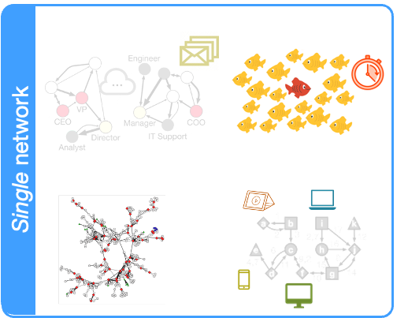
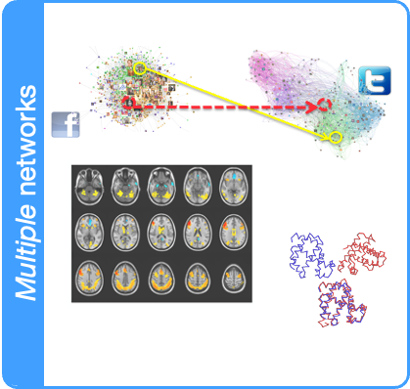
Applications of Structural Role Mining
Summarization / Compression
Long-range link prediction, …

Slide 21
Tutorial Outline:
Network Embedding for Role Discovery
Part I: Lecture
  Introduction
  Structural roles in
    network science
    mathematical sociology
  Structural or role-based embedding methods
  Mining structural roles within a network
  Mining structural roles across networks
Part II: Demo
  Hands-on demo

Slide 22
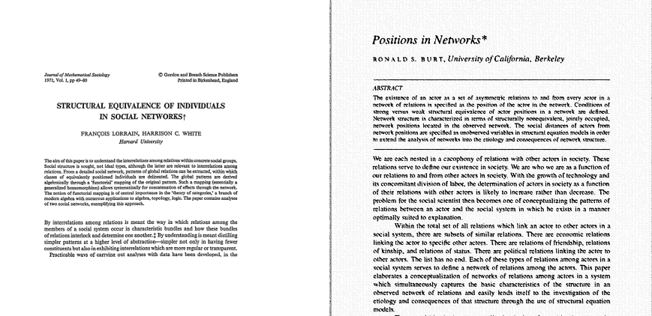
Let’s travel back in time…
circa 1971-1976

Slide 23
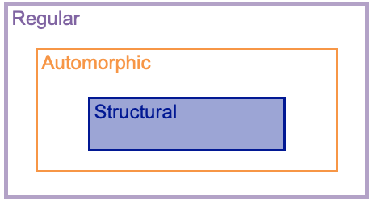
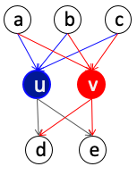
Deterministic equivalences
Nodes u and v are structurally equivalent if they have the same relationships to all other nodes
Rare in real networks
Proximity-based methods tend to capture structural equivalence.

Slide 24
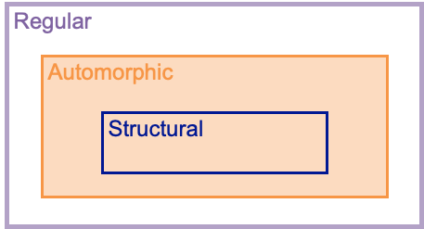
Deterministic equivalences
Nodes u and v are automorphically equivalent if all the nodes can be relabeled to form an isomorphic graph with the labels of u and v interchanged
They share the same label-independent properties
0
1
2
3
4
5
6
7
8
9
Automorphically Equivalent Groups:
{0, 1} {2, 4} {5, 6, 8, 9}

Slide 25
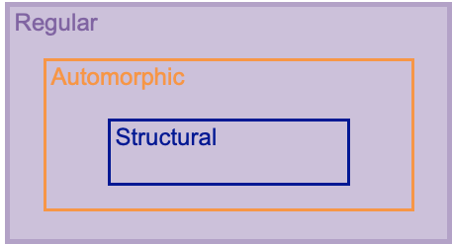
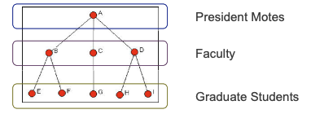
Deterministic equivalences
Nodes u and v are regularly equivalent if they are equally related to equivalent nodes

Slide 26
Sociological Role Equivalence
STRUCTURAL
Equivalence
AUTOMORPHIC Equivalence
REGULAR
Equivalence
Two nodes are structurally equivalent iff they have identical connections with identical nodes
Two nodes are automorphically equivalent iff there is an automorphism that maps one node to the other
Two nodes are regularly equivalent if they relate in the same way to equivalent nodes
0
1
0
1
0
1
2
3
4
2
3
4
2
3
4
5
6
7
8
9
5
6
7
8
9
5
6
7
8
9
Structurally Equivalent Group:
{0, 1}
Automorphically Equivalent Group:
{0, 1} {2, 4} {5, 6, 8, 9}
Regularly Equivalent Group:
{0, 1} {2, 3, 4} {5, 6, 7, 8, 9}
Notes:
There are various types of equivalences in the sociology literature. We mainly focus on three types - structural, automorphic and regular.
[Structural Equivalence]
Two nodes are structurally equivalent if and only if they have identical connections with identical nodes. This is a strict definition and requires that equivalent nodes be in close proximity through their mutual neighbors.
[Automorphic Equivalence]
Two nodes are automorphically equivalent if and only if there is an automorphism that maps one node to the other: equivalent nodes have perfectly corresponding, even if not identical, sets of connections.
[Regular Equivalence]
Regular equivalence is the most interesting and prevalent equivalence type in real networks.
Two nodes are regularly equivalent if they relate in the same way to equivalent nodes.
Special notice to the colored dashed lines here. They denote the same relationship between the layers of the nodes.
In this graph, nodes on the same layer are of the same regular equivalence class.

Slide 27

for Generating Equivalence
STRUCTURAL
Equivalence
AUTOMORPHIC Equivalence
REGULAR
Equivalence
Two nodes are structurally equivalent iff they have identical connections with identical nodes
Two nodes are automorphically equivalent iff there is an automorphism that maps one node to the other
Two nodes are regularly equivalent if they relate in the same way to equivalent nodes
CONCOR
[Ronald+ ‘75]
MAXSIM
[Martin+ ‘88]
CatRege
[Stephen+ ‘92]
Adjacency Matrix
Similarity Matrix
Adjacency Matrix
Similarity Matrix
Adjacency Matrix
Similarity Matrix
0
1
1
..
..
0
1
1
..
..
0
A
B
..
..
1
0
0
..
..
1
0
0
..
..
A
0
0
..
..
1
0
0
..
..
1
0
0
..
..
B
0
0
..
..
..
..
..
..
..
..
..
..
..
..
..
..
..
..
..
..
..
..
..
..
..
..
..
..
S_{ij} = S_{ji}: Pearson correlation between nodes i and j
S_{ij} = S_{ji}: the similarity of distributions of geodesic distances between nodes i and j to all other nodes
S_{ij} = S_{ji}: the iteration nodes i and j separated when successively matching node neighborhoods
[Jin, Heimann, Jin, Koutra. 2021. Toward Understanding and Evaluating Structural Node Embeddings. ACM TKDD 2021]
Notes:
For these three types of equivalences, we use sociologists’ UCINET software. The software uses relaxed equivalence notions to compute an equivalence-based similarity matrix.
[Structural Equivalence]
The CONCOR algorithm is used for structural equivalence. It uses the Pearson correlation between rows of the adjacency matrix as the structural similarity of those nodes
[Automorphic Equivalence]
The MAXSIM algorithm computes automorphic equivalence of nodes based on the distribution of their geodesic distances to all other nodes.
the geodesic distance between two nodes is the length of the shortest path between the nodes
[Regular Equivalence]
CatRege is used for calculating regular equivalence. The method searches for matches in successive node neighborhoods. It generates a similarity matrix, where each entry encodes the iteration in which two nodes were separated into different groups or classes.

Slide 28
Related Sociology Literature
•S.P. Borgatti and M.G. Everett. 1992. Notions of position in social network analysis. Sociological methodology 22, 1 (1992)
•Stephen P Borgatti, Martin G Everett, and Jeffrey C Johnson. 2018. Analyzing social networks. Sage
•F. Lorrain and H.C. White. 1971. Structural equivalence of individuals in social networks. Journal of Mathematical Sociology
•S. Boorman, H.C. White: Social Structure from Multiple Networks: II. Role Structures. American Journal of Sociology, 81:1384-1446, 1976.
•R.S. Burt: Positions in Networks. Social Forces, 55:93-122, 1976.
•M.G. Everett, S. P. Borgatti: Regular Equivalence: General Theory. Journal of Mathematical Sociology, 19(1):29-52, 1994.
•K. Faust, A.K. Romney: Does Structure Find Structure? A critique of Burt's Use of Distance as a Measure of Structural Equivalence. Social Networks, 7:77-103, 1985.
•K. Faust, S. Wasserman: Blockmodels: Interpretation and Evaluation. Social Networks, 14:5–61. 1992.
•R.A. Hanneman, M. Riddle: Introduction to Social Network Methods. University of California, Riverside, 2005.
•L.D. Sailer: Structural Equivalence: Meaning and Definition, Computation, and Applications. Social Networks, 1:73-90, 1978.
•M.K. Sparrow: A Linear Algorithm for Computing Automorphic Equivalence Classes: The Numerical Signatures Approach. Social Networks, 15:151-170, 1993.
•S. Wasserman, K. Faust: Social Network Analysis: Methods and Applications. Cambridge University Press, 1994.
•H.C. White, S. A. Boorman, R. L. Breiger: Social Structure from Multiple Networks I. Blockmodels of Roles and Positions. American Journal of Sociology, 81:730-780, 1976.
•D.R. White, K. Reitz: Graph and Semi-Group Homomorphism on Networks and Relations. Social Networks, 5:143-234, 1983.
•…

Slide 29
Tutorial Outline:
Network Embedding for Role Discovery
Part I: Lecture
  Introduction
  Structural roles in
    network science
    mathematical sociology
  Structural or role-based embedding methods
  Mining structural roles within a network
  Mining structural roles across networks
Part II: Demo
  Hands-on demo

Slide 30

A lot of work on
network representation learning
…

Slide 31
Learning with Graphs
4
1
2
3
Edges
4
Node features
Cluster similar nodes
Nodes
1
1
2
Standard ML
3
1
4
3
4
2
3
2
Classify node properties
Notes:
The traditional approach to getting features for nodes in networks is to aggregate hand-engineered statistics, for example, degree and Pagerank. Though they are interpretable, it is hard to select the most informative statistics and the hand designing is simplistic.
This has led to interest in node embedding methods, which learn latent features where “similar nodes should be close in the embedding space”. Thus, the embedding features preserve complex similarity among the nodes.

Slide 32


Feature vector for each node in a network
How to Get Node Features?
f₁
f₄
y₂
y₄
Number of connections
y₄
degree
4
degree
4
y₃
Importance
pagerank
pagerank
y₁
...
...
y₂
1
1
y₃
f₃
f₂
y₁
3
3
degree
Similar nodes
→ cluster in embedding space
degree
pagerank
2
pagerank
2
...
...
Traditional Approaches: Hand-Engineered Features
Interpretable
Simplistic, hard to select
Node Embeddings
Latent features
Preserve complex similarity
[Perozzi+ ‘14], [Tang+ ‘15], [Grover+ ‘16], [Ribeiro+ ‘17], ...
Notes:
The traditional approach to getting features for nodes in networks is to aggregate hand-engineered statistics, for example, degree and Pagerank. Though they are interpretable, it is hard to select the most informative statistics and the hand designing is simplistic.
This has led to interest in node embedding methods, which learn latent features where “similar nodes should be close in the embedding space”. Thus, the embedding features preserve complex similarity among the nodes.

Slide 33
LINE
Primarily model node proximity rather than structural roles
Embedding objective: learn similar representations for first and second order neighbors
[Tang, Qu, et al. WWW, 2015]

Slide 34
GCN-VAE
Use graph convolutional network to learn node feature vectors
Autoencoder paradigm: training objective is for features to reconstruct graph structure (similar features = nodes share an edge)
GCN
[Kipf & Welling. NeurIPS workshop on Bayesian Deep Learning 2016]

Slide 35

xNetMF
Characterize connectivity statistics of local neighborhood
Embedding objective: similar embeddings for similar neighborhoods
Degree histogram of k-hop neighbors
Degree1
0
1
2
1
[Heimann, Shen, et al. CIKM 2018]

Slide 36
MultiLENS
Characterize distribution of structural statistics of local neighborhood
Embedding: Low rank decomposition of feature matrix
Degree or other structural statistic histogram of k-hop neighbors
Degree1
0
1
2
1
≈
[Jin, Rossi, et al. KDD 2019]

Slide 37
SEGK
Extract local neighborhood around each node
Characterize local neighborhood using graph kernels
Embedding objective: similar embeddings for similar neighborhoods
[Nikolentzos and Vazirgiannis. TKDE 2019]

Slide 38

node2vec
Perform random walks on graph
Embedding objective: similar embeddings for nodes that co-occur in random walks
…
[Grover and Leskovec. KDD 2016]
Notes:
It is claimed that the random walks can be biased to capture “structural equivalence” – though from context, automorphic equivalence may be more what is meant. With that said, node2vec as a primarily proximity-preserving method mainly does model structural equivalence as opposed to automorphic or regular equivalence.

Slide 39
struc2vec
Perform random walks on structural similarity graph
Structural similarity determined by comparing neighborhood connectivity statistics at multiple levels
Same embedding objective: similar embeddings for nodes that co-occur in random walks
[Ribeiro et al. KDD 2017]

Slide 40
role2vec
Relabel nodes by structural role
Perform random walks on original graph
Embedding objective: embed nodes similarly that co-occur with similar types
[Ahmed et al. DLG KDD 2019]

Slide 41
RiWalk
Extract subgraph around each node
Relabel structural positions of nodes in each subgraph
Perform random walks on subgraph, same embedding objective
[Xuewei et al.. ICDM 2019]

Slide 42
DRNE
Sort neighborhoods by degree
Aggregate neighbors’ embeddings using LSTM
Additional regularization so that embedding approximates node degree
Claims to have some power to model regular equivalence
LSTM
[Tu et al.. KDD 2018]
Notes:
We will put to the test how well the embeddings model structural properties like node degree, or sociological equivalences like regular equivalence

Slide 43
GraphWave
Perform heat diffusion on graph
Node features = shape of heat distribution sent to other nodes
[Donnat et al. KDD 2018]

Slide 44
Phusion: Unifying Role and Proximity-based Embeddings
Role-based and proximity-based methodologies different? [Rossi et. al TKDD 2021] Or similar? [ICLR 2020]
PhUSION: construct unified framework for proximity-preserving and role-based embedding
Allows for sharing of design choices like proximity function, added nonlinearity
Proximity-based embedding
Pairwise node proximities
Factorization
PageRank, heat kernel, etc.
proximity function
nonlinear filter
Role-based embedding
Distribution shape
Elementwise log, binarization, etc.
[Zhu, Lu, et al. SDM 2021]

Slide 45
(maybe add references to more structural embedding methods)

Slide 46
Tutorial Outline:
Network Embedding for Role Discovery
Part I: Lecture
  Introduction
  Structural roles in
    network science
    mathematical sociology
  Structural or role-based embedding methods
  Mining structural roles within a network
  Mining structural roles across networks
Part II: Demo
  Hands-on demo
Questions so far??

Slide 47
Tutorial Outline:
Network Embedding for Role Discovery
Part I: Lecture
  Introduction
  Structural roles in
    network science
    mathematical sociology
  Structural or role-based embedding methods
  Mining structural roles within a network
  Mining structural roles across networks
Part II: Demo
  Hands-on demo

Slide 48




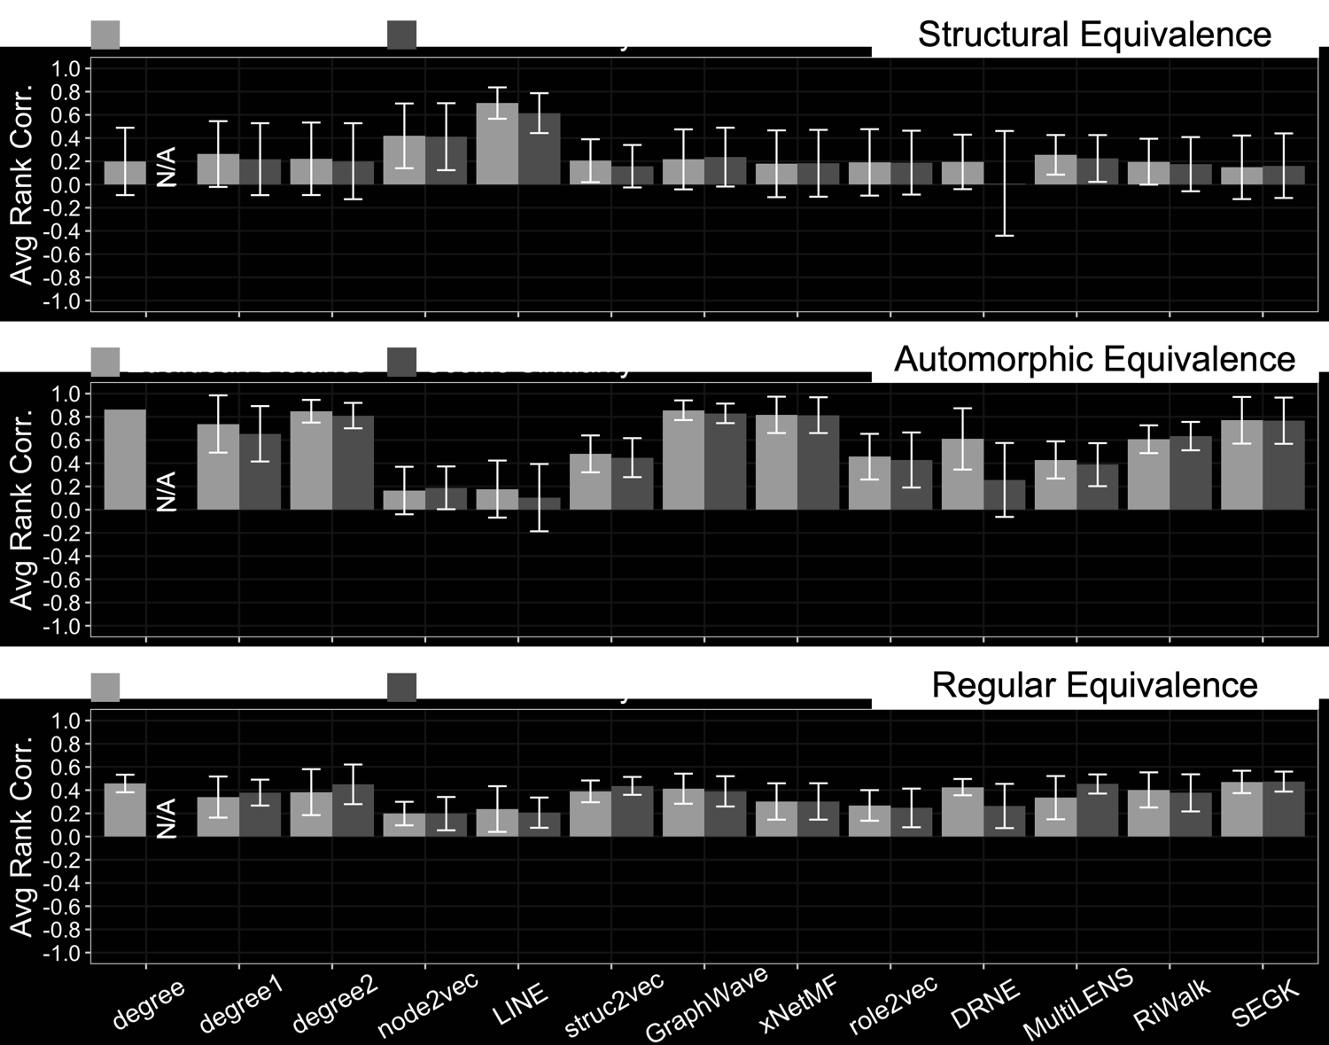
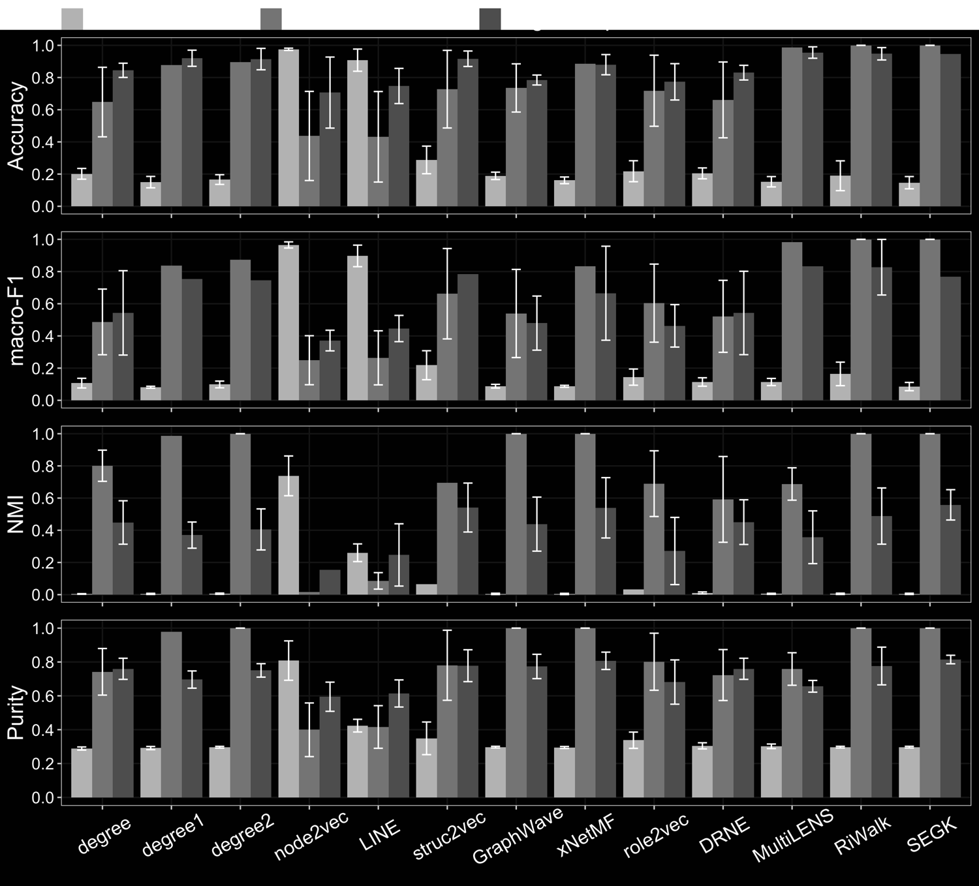





Connecting Network Embedding & Sociology
STRUCTURAL
Equivalence
node2vec/LINE
GCN-VAE
struc2vec
GraphWave
Identical relationships to all other nodes
xNetMF
role2vec
DRNE
MultiLENS
RiWalk
SEGK
AUTOMORPHIC Equivalence
Structural Embedding Methods
Structure-preserving mapping between nodes
Synthetic Datasets
INTRINSIC
EXTRINSIC
REGULAR
Equivalence
Protein
Blog
Air Traffic
Facebook
Email
...
Equivalent relationships to equivalent other nodes
Real Datasets
Evaluation
[Jin, Heimann, Jin, Koutra. 2021. Toward Understanding and Evaluating Structural Node Embeddings. ACM TKDD 2021]
Notes:
To answer the first research question, we turn to sociology literature. The sociologists have defined “structural, automorphic and regular” role equivalence.
For the second and third research questions, we designed synthetic datasets and gathered real datasets. We run most of the existing structural embedding methods on these datasets, using intrinsic and extrinsic evaluation methods we designed.

Slide 49
Additional Structural “Embedding” Method:
Degree Histograms
Degree-k: degree histogram of k-hop neighbors
Degree, Degree1, Degree2 variants
4
3
2
Degree1
0
1
2
1
3
0 neighbors of degree 1
1 neighbor of degree 2
2 neighbors of degree 3
1 neighbor of degree 4
[Jin, Heimann, Jin, Koutra. 2021. Toward Understanding and Evaluating Structural Node Embeddings. ACM TKDD 2021]
Notes:
Counts of neighbors by degree will appear

Slide 50


Structural Embedding Graph Library
https://github.com/GemsLab/StrucEmbedding-GraphLibrary
We’ll use this graph library during the hands-on part of this tutorial!

Slide 51

Intrinsic and Extrinsic Evaluation
Adjacency Matrix
Similarity Matrix
Adjacency Matrix
0
1
1
..
..
0
1
1
..
1
0
0
..
..
1
0
0
..
1
0
0
..
CONCOR / MAXSIM / CatRege
..
1
0
0
..
Kendall Rank Correlation
..
..
..
..
..
..
..
..
..
..
..
..
..
CONCOR / MAXSIM / CatRege
..
Embedding Methods
Embedding Methods
Similarity Matrix
..
Similarity Matrix
..
..
..
..
..
..
..
..
..
..
..
..
..
Hierarchical Clustering
Labels
Clustering /
Classification
Intrinsic Evaluation doesn’t involve any downstream machine learning model
Pre-defined Labels
[Jin, Heimann, Jin, Koutra. 2021. Toward Understanding and Evaluating Structural Node Embeddings. ACM TKDD 2021]
Notes:
For intrinsic evaluation
Given the adjacency matrix of a graph, we use the UCINET software to generate the similarity matrix for a specific type of role equivalence.
The embedding methods generate the node embeddings, with which we can also build a similarity matrix using cosine similarity or inverse of euclidean distance.
For each node, we have its similarity to all the other nodes, both using equivalence similarities from UCINET and also from embedding similarities. We use the Kendall Rank correlation to see how these two types of similarities match.
[Extrinsic Evaluation]
The extrinsic evaluation needs the labels for each node. The labels either come from the hierarchical clustering on the UCINET similarity matrix or are provided in the dataset.
We perform clustering or classification on the node embeddings generated by the embedding methods and perform the evaluation accordingly.
We can see that the Intrinsic Evaluation doesn’t involve any downstream machine learning model. So it is more purely dependent on the embeddings alone.

Slide 52
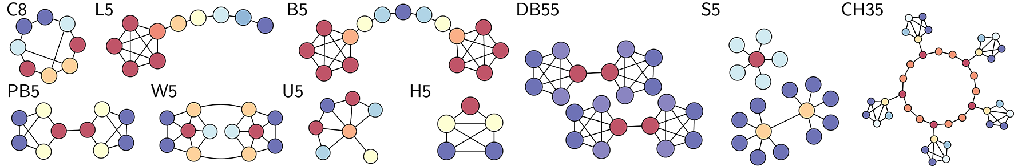
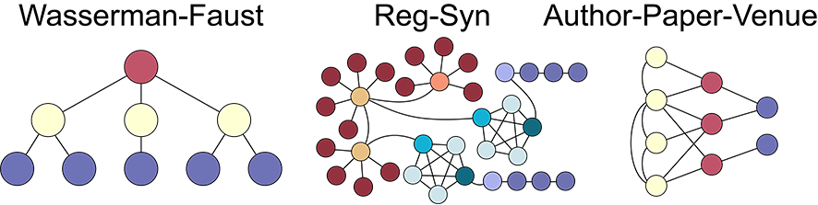
Synthetic Datasets: Base
Identically colored nodes are automorphically equivalent
Identically colored nodes are regularly equivalent
[Jin, Heimann, Jin, Koutra. 2021. Toward Understanding and Evaluating Structural Node Embeddings. ACM TKDD 2021]

Slide 53
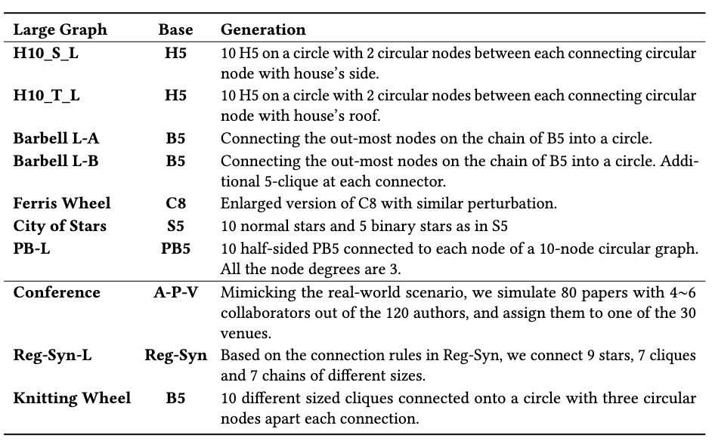
Building Complex Synthetic Benchmarks
[Jin, Heimann, Jin, Koutra. 2021. Toward Understanding and Evaluating Structural Node Embeddings. ACM TKDD 2021]

Slide 54
Real Datasets: Single Network Mining
Real Datasets
Dataset | # Nodes | # Edges | Labels
BlogCatalog | 10,312 | 333,983 | Centralities
Facebook | 4,039 | 88,234 | Equivalences
ICEWS | 1,255 | 1,414 | military vs media entities
Email-300 | 318 | 752 | professional roles
Email-2K | 2,414 | 11,995 | professional roles
PPI | 56,944 | 818,786 | protein cellular functions
BR air-traffic | 131 | 1,038 | traffic heaviness
EU air-traffic | 399 | 5,995 | traffic heaviness
US air-traffic | 1,190 | 13,599 | traffic heaviness
DD6 | 4,152 | 20,640 | amino acid properties
Calculate structural
node properties
(intrinsic evaluation)
Node labels correspond to structural roles
(extrinsic evaluation)
[Jin, Heimann, Jin, Koutra. 2021. Toward Understanding and Evaluating Structural Node Embeddings. ACM TKDD 2021]

Slide 55

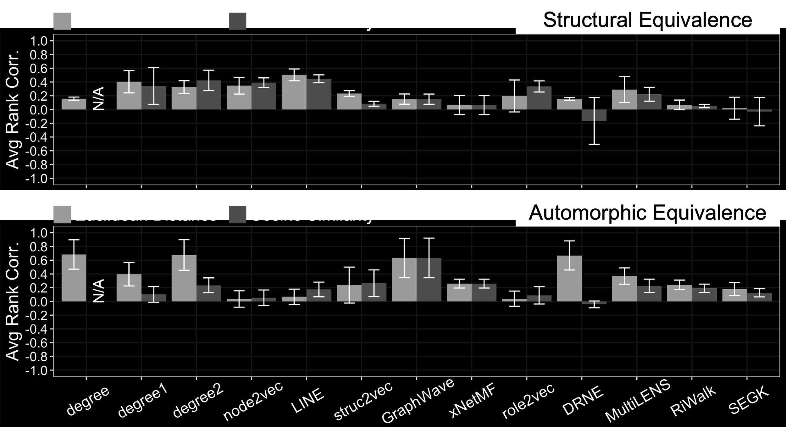
Intrinsic Evaluation - Results
node2vec
node2vec
LINE
LINE
Real Datasets
Obs. 1: LINE and node2vec rank top in structural equivalence
(as expected; based on proximity)
Synthetic Datasets
[Jin, Heimann, Jin, Koutra. 2021. Toward Understanding and Evaluating Structural Node Embeddings. ACM TKDD 2021]
Notes:
This is the evaluation result for the intrinsic evaluation.
The first observation is that LINE and node2vec rank top in structural equivalence. This aligns with our expectation, since despite the name, structural equivalence depends on node proximity.

Slide 56
Intrinsic Evaluation - Results
proximity-based
GraphWave
proximity-based
GraphWave
Degree2
xNetMF
SEGK
degree2
xNetMF
SEGK
Real Datasets
proximity-based
Obs. 2: Structural embedding methods do well in automorphic and regular equivalence
Degree2
struc2vec
Degree
GraphWave
MultiLENS
DRNE
Synthetic Datasets
[Jin, Heimann, Jin, Koutra. 2021. Toward Understanding and Evaluating Structural Node Embeddings. ACM TKDD 2021]
Notes:
On the other hand, structural embedding methods such as GraphWave, xNetMF and SEGK, as well as degree2, work well in terms of automorphic equivalence, while the proximity-based methods LINE and node2vec do not. This is also expected, as automorphically similar nodes need not be in close proximity in the graph.
Similarly, the proximity-based methods struggle to capture regular equivalence, better captured by Degree, GraphWave and DRNE based on Euclidean distance, and degree2, struc2vec and MultiLENS based on cosine similarity.

Slide 57
Intrinsic Evaluation - Results
Degree
Degree1
Degree2
Degree
Degree1
Degree2
Real Datasets
Obs. 3: Degree Variants may indeed be good indicators of the structural position / role
Degree
Degree1
Degree2
Synthetic Datasets
[Jin, Heimann, Jin, Koutra. 2021. Toward Understanding and Evaluating Structural Node Embeddings. ACM TKDD 2021]
Notes:
Degree variants work quite well in capturing automorphic and regular equivalence. They may indeed be good indicators of the structural position or role.

Slide 58
Intrinsic and Extrinsic Evaluation
Adjacency Matrix
Similarity Matrix
Adjacency Matrix
0
1
1
..
..
0
1
1
..
1
0
0
..
..
1
0
0
..
1
0
0
..
CONCOR / MAXSIM / CatRege
..
1
0
0
..
Kendall Rank Correlation
..
..
..
..
..
..
..
..
..
..
..
..
..
CONCOR / MAXSIM / CatRege
..
Embedding Methods
Embedding Methods
Similarity Matrix
..
Similarity Matrix
..
..
..
..
..
..
..
..
..
..
..
..
..
Hierarchical Clustering
Labels
Clustering /
Classification
Intrinsic Evaluation doesn’t involve any downstream machine learning model
Pre-defined Labels
[Jin, Heimann, Jin, Koutra. 2021. Toward Understanding and Evaluating Structural Node Embeddings. ACM TKDD 2021]
Notes:
Let’s then turn to the extrinsic evaluation. The labels are generated by the hierarchical clustering from the similarity matrix output by UCINET.

Slide 59

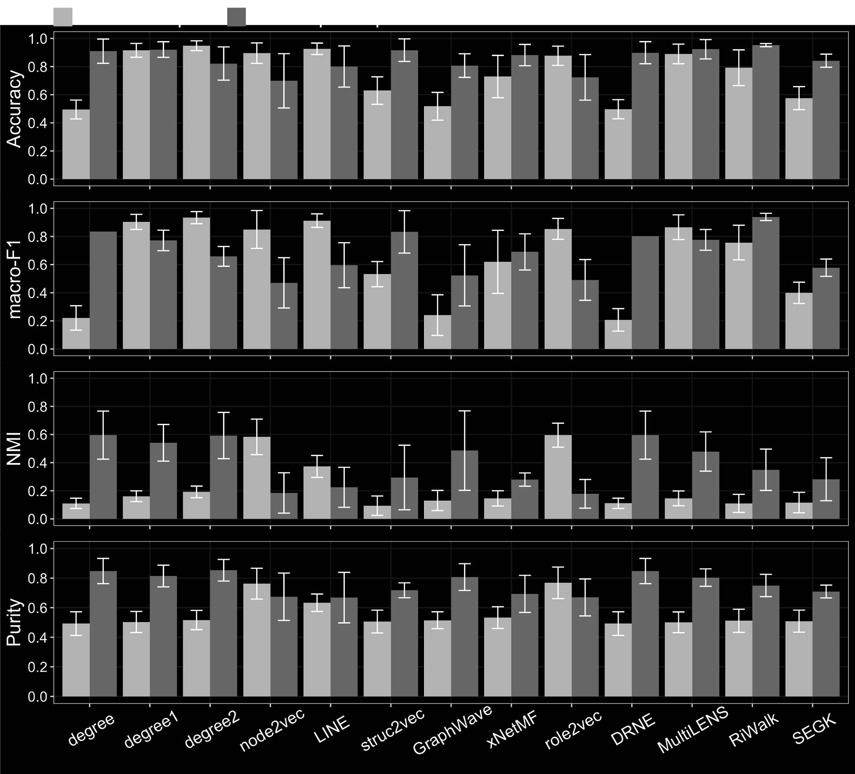
Extrinsic Evaluation - Results
Degree
Proximity
Degree
Proximity
Synthetic Datasets
Real Datasets
Obs. 4: Similar results between intrinsic and extrinsic evaluation as well as synthetic versus real networks with one exception - MultiLENS
Notes:
We observe the similar results between the intrinsic evaluation and extrinsic evaluation for our degree features [animation] and proximity-preserving embeddings [animation]. Structural embeddings follow largely similar trends except for MULTILENS.

Slide 60
Extrinsic Evaluation
Synthetic Datasets - Extrinsic
Synthetic Datasets - Intrinsic
Obs. 5: Intrinsic evaluations of embeddings may not always accurately predict performance in downstream tasks - involvement of downstream ML models
[Jin, Heimann, Jin, Koutra. 2021. Toward Understanding and Evaluating Structural Node Embeddings. ACM TKDD 2021]
Notes:
MULTILENS ranks top in extrinsic evaluation on the left but ranks middle in intrinsic evaluation on the right. The involvement of the downstream machine learning models might lead to the inconsistency between intrinsic and extrinsic evaluation.

Slide 61
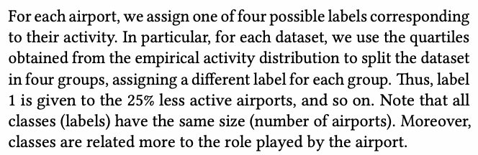
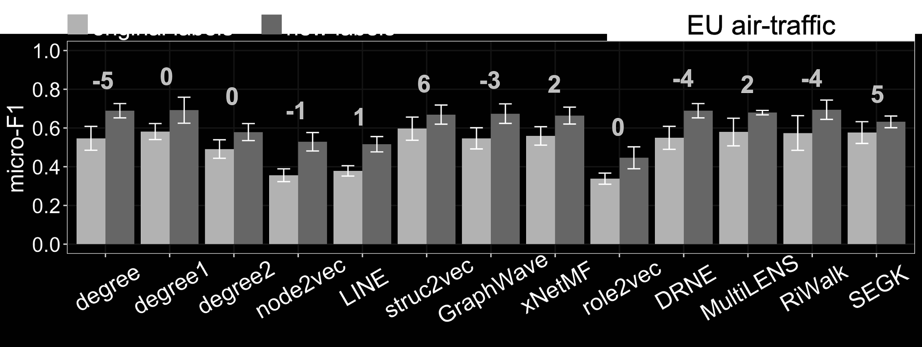
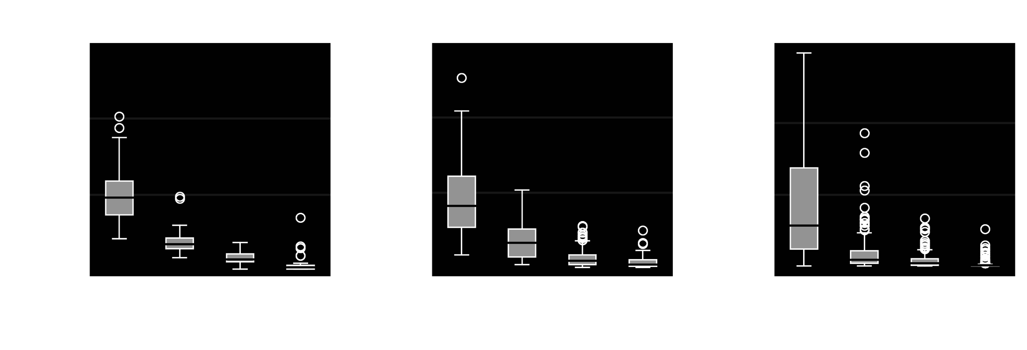
Issues with Label Definitions
Original Label Splitting Manner
0%-25%
25%-50%
50%-75%
75%-100%
New Label Splitting Manner (Log → Power Law)
activity^1/4
activity^2/4
activity^3/4
[struc2vec, Leonardo+ ‘17]
Decrease in performance rank w.r.t. new labels
Obs. 6: Labels strongly correlated with node degree for air-traffic datasets
Obs. 7: Each structural embedding method best captures certain structural roles in the network, but unclear how well these roles are correlated with the labels
[Jin, Heimann, Jin, Koutra. 2021. Toward Understanding and Evaluating Structural Node Embeddings. ACM TKDD 2021]
Notes:
The most widely used datasets for evaluating the structural node embedding methods are the airports dataset, where nodes represent airports and labels represent flight activity. The labels assigned are actually strongly correlated to the node degree.
Also, the author evenly split the dataset into four quarters, but if we re-split the datasets following the Power Law, we see that the rank of the performance of each method differs greatly. Each structural embedding method best captures certain structural roles in the network, but it’s unclear how well these roles are correlated with the labels. We think it’s instructive for all researchers to consider, beyond structural embeddings, how dataset labels can be an arbitrary way to represent the underlying phenomena and how this can affect results.

Slide 62
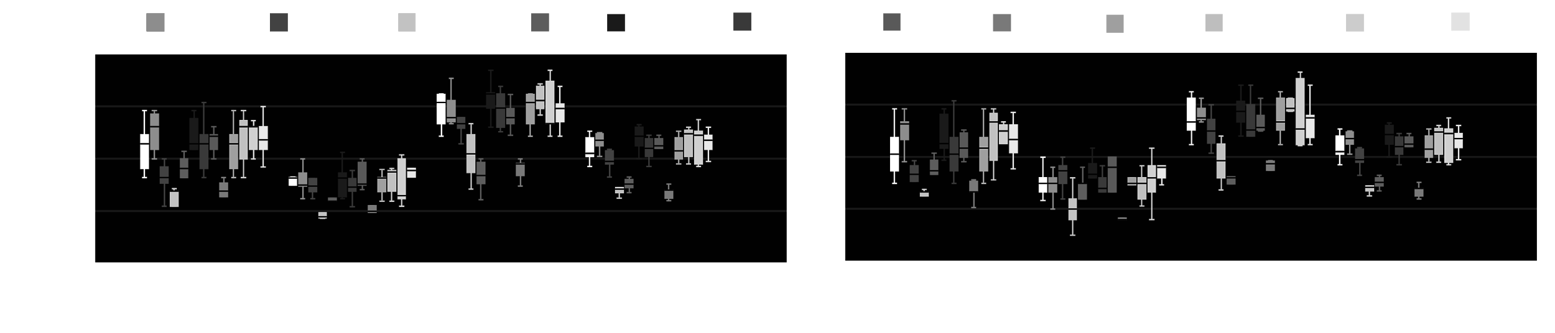
Deeper View into Performance Scores
[0, max_property^{1/3})
[max_property^{1/3}, max_property^{2/3})
[max_property^{2/3}, max_property]
Clustering / Classification
Clustering / Classification
Clustering / Classification
EU Air-traffic with Original Label
Obs. 8: Extreme nodes with (low/high) (degree/#triangles) tend to perform better with evaluation task
[Jin, Heimann, Jin, Koutra. 2021. Toward Understanding and Evaluating Structural Node Embeddings. ACM TKDD 2021]
Notes:
Next, we want to see within a graph which nodes are most likely to be successfully described by structural embeddings. We group nodes into low, medium and high node classes based on a property like node degree or the number of participating triangles. For each node class we perform the extrinsic evaluation.
Performance is generally best in the high node classes. This makes sense since these nodes contain richer information. But it is surprising to see the second-best performance in the low node classes. This suggests that it may be easier for structural embedding methods to distinguish “extreme” network positions rather than moderate ones.

Slide 63
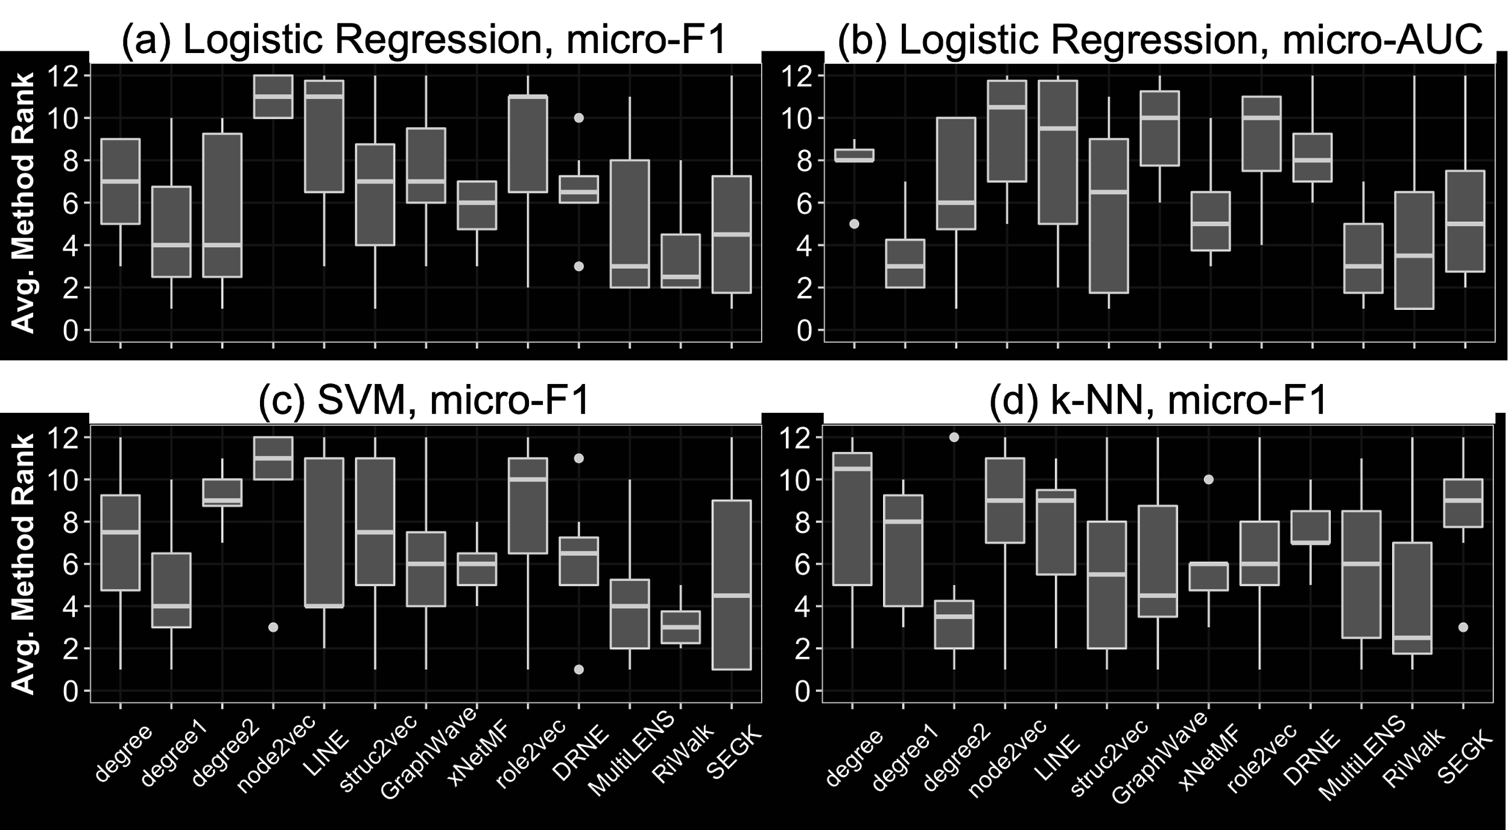
Overall Performance with Pre-defined Labels
Lower is better: performance ranking summarized across all real datasets with pre-defined labels
Obs. 9: Different classifiers or performance metrics also affect performance.
Obs. 10: Methods capturing the degree distributions in local neighborhoods are among the most effective (xNetMF, MultiLENS, SEGK, degree variants)
[Jin, Heimann, Jin, Koutra. 2021. Toward Understanding and Evaluating Structural Node Embeddings. ACM TKDD 2021]
Notes:
This plot summarizes the rank of each method among all the real datasets, taking into account that different classifiers or performance metrics also affect performance.
Though there is no global winner, methods capturing the degree distributions in local neighborhoods are among the most effective. These methods include xNetMF, MultiLENS, SEGK and degree variants.

Slide 64
Tutorial Outline:
Network Embedding for Role Discovery
Part I: Lecture
  Introduction
  Structural roles in
    network science
    mathematical sociology
  Structural or role-based embedding methods
  Mining structural roles within a network
  Mining structural roles across networks
Part II: Demo
  Hands-on demo

Slide 65
Embedding-based Network Alignment
Task: match corresponding nodes across networks
REGAL Framework: Match nodes with similar structural node embeddings [Heimann+ ‘18]
Observation: structural roles are often comparable across networks
[Jin, Heimann, Jin, Koutra. 2021. Toward Understanding and Evaluating Structural Node Embeddings. ACM TKDD 2021]

Slide 66
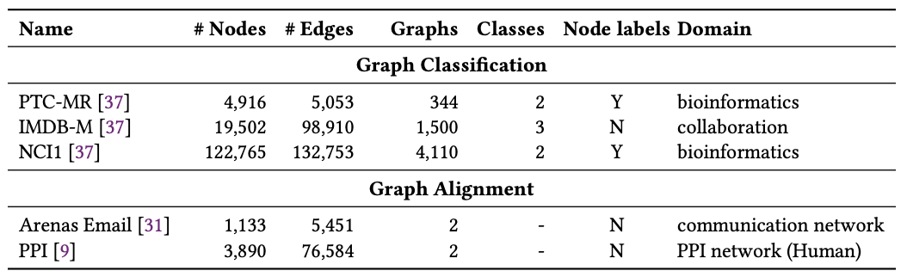
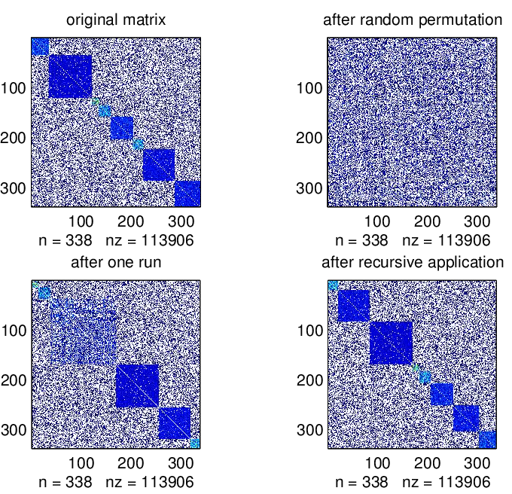
Network Alignment: Setup
Datasets: Networks with real-world structure from multiple domains
Setup: Align graphs with adj matrices A and B = PAP^{T} + noise
random permutation matrix
A
B
remove edges from A with probability p_{a}
[Jin, Heimann, Jin, Koutra. 2021. Toward Understanding and Evaluating Structural Node Embeddings. ACM TKDD 2021]
Notes:
We also gather real datasets of various sizes and make synthetic datasets with distinctive role equivalences of nodes to make a comprehensive empirical study.

Slide 67
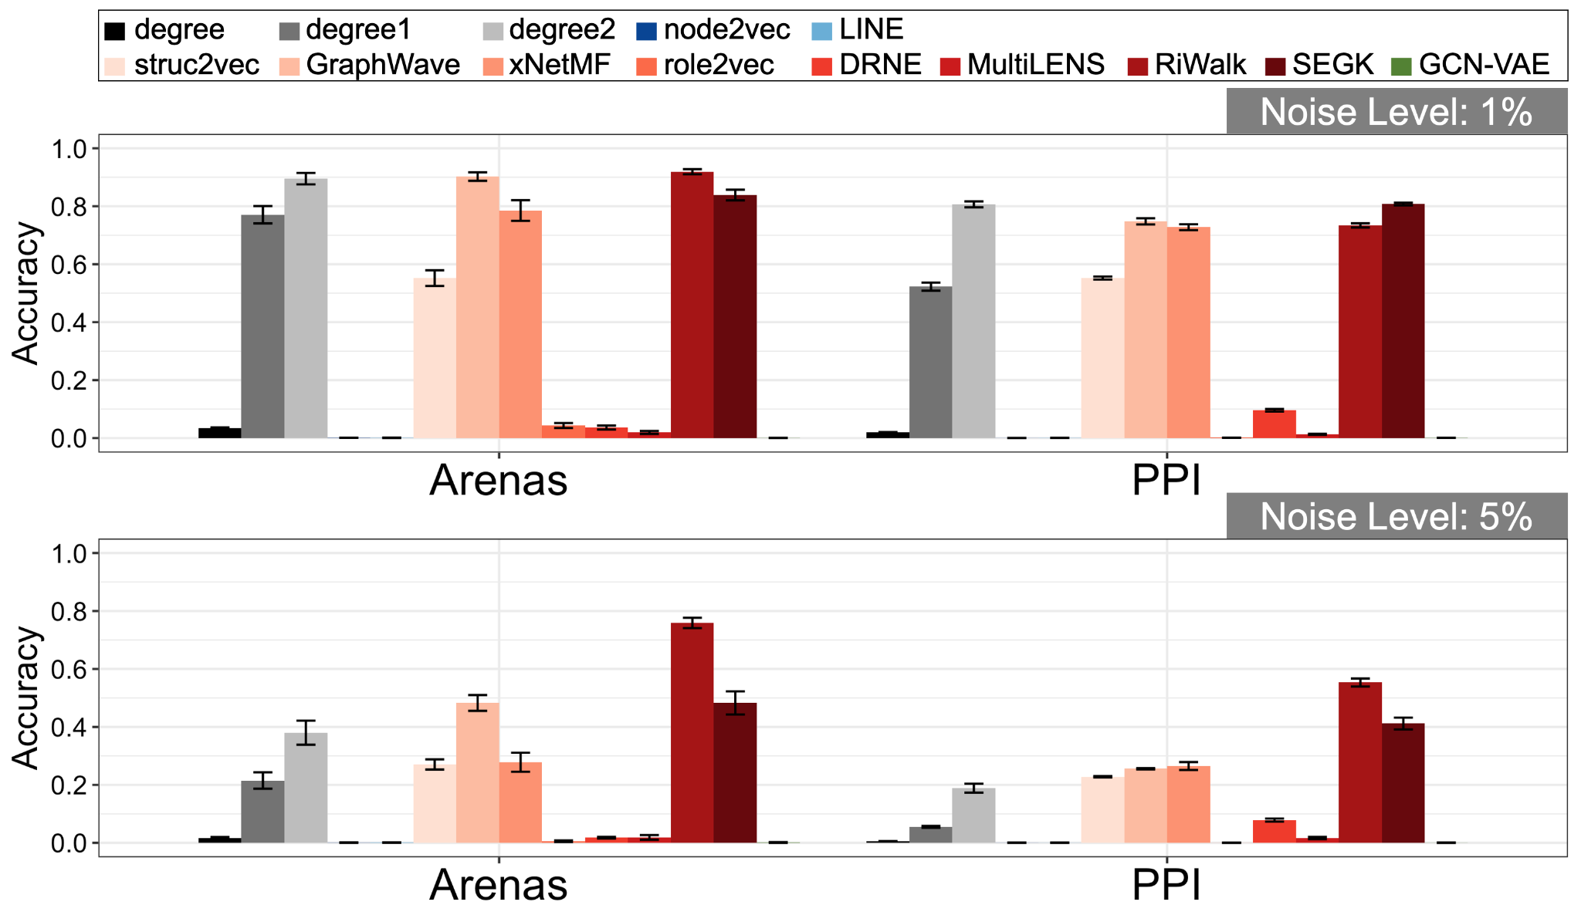
Network Alignment: Results
❌ Proximity-preserving methods (LINE, node2vec, GCN-VAE)
and ones using related techniques (role2vec, DRNE, MultiLENS)
✅ xNetMF (Originally proposed), degree1 and 2
Use higher-order local degree connectivity
✅✅ Improvement: SEGK (uses WL test to generalize notion of connectivity beyond degree)
✅✅✅ Best: RiWalk (also doesn’t restrict itself to local neighborhoods)
[Jin, Heimann, Jin, Koutra. 2021. Toward Understanding and Evaluating Structural Node Embeddings. ACM TKDD 2021]
Notes:
We also gather real datasets of various sizes and make synthetic datasets with distinctive role equivalences of nodes to make a comprehensive empirical study.

Slide 68
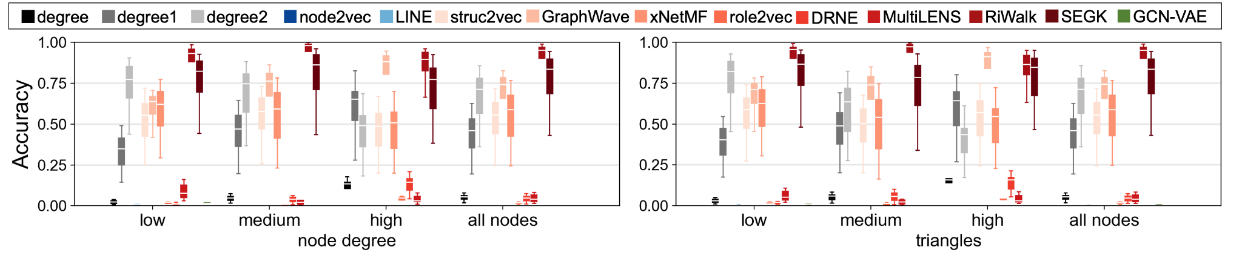
Network Alignment: Deeper Insights
Observation: Some methods (e.g. degree1, GraphWave) do better on high-connectivity nodes
More distinguishing structural informatio\n, though also more susceptible to noise model
Observation: Best method (e.g. RiWalk) fairly consistent across connectivity level (thanks to generalizing notion of connectivity beyond degree)
[Jin, Heimann, Jin, Koutra. 2021. Toward Understanding and Evaluating Structural Node Embeddings. ACM TKDD 2021]
Notes:
We also gather real datasets of various sizes and make synthetic datasets with distinctive role equivalences of nodes to make a comprehensive empirical study.

Slide 69
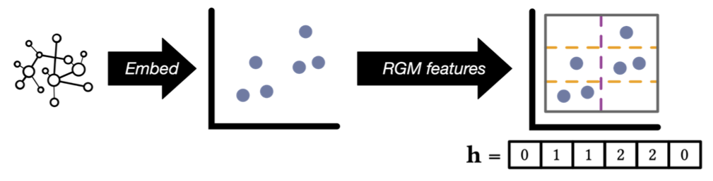
Embedding-based Graph Classification
Task: predict label of entire graph (design feature vector for ML classifier)
RGM Framework: Graph features = distribution of node features in latent space
Observation: structural roles are often comparable across networks [Heimann+ ‘19]
[Jin, Heimann, Jin, Koutra. 2021. Toward Understanding and Evaluating Structural Node Embeddings. ACM TKDD 2021]

Slide 70
Graph Classification: Setup
Datasets: Common graph classification benchmarks from multiple domains
Setup: Train kernel SVM on top of RGM features
[Jin, Heimann, Jin, Koutra. 2021. Toward Understanding and Evaluating Structural Node Embeddings. ACM TKDD 2021]
Notes:
We also gather real datasets of various sizes and make synthetic datasets with distinctive role equivalences of nodes to make a comprehensive empirical study.

Slide 71
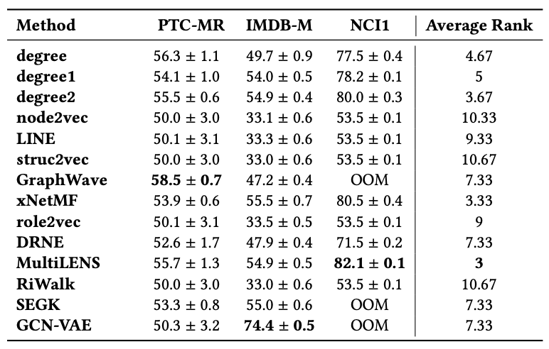
Graph Classification: Results
Small molecule dataset PTC-MR may have less complex structural roles, leading to similar performance for most methods
Random-walk based sampling methods perform poorly
blur structural information too much on small graphs
Note: competitive to SOTA, e.g. GCN-VAE on IMDB-M (of independent interest)
[Jin, Heimann, Jin, Koutra. 2021. Toward Understanding and Evaluating Structural Node Embeddings. ACM TKDD 2021]
Notes:
We also gather real datasets of various sizes and make synthetic datasets with distinctive role equivalences of nodes to make a comprehensive empirical study.

Slide 72
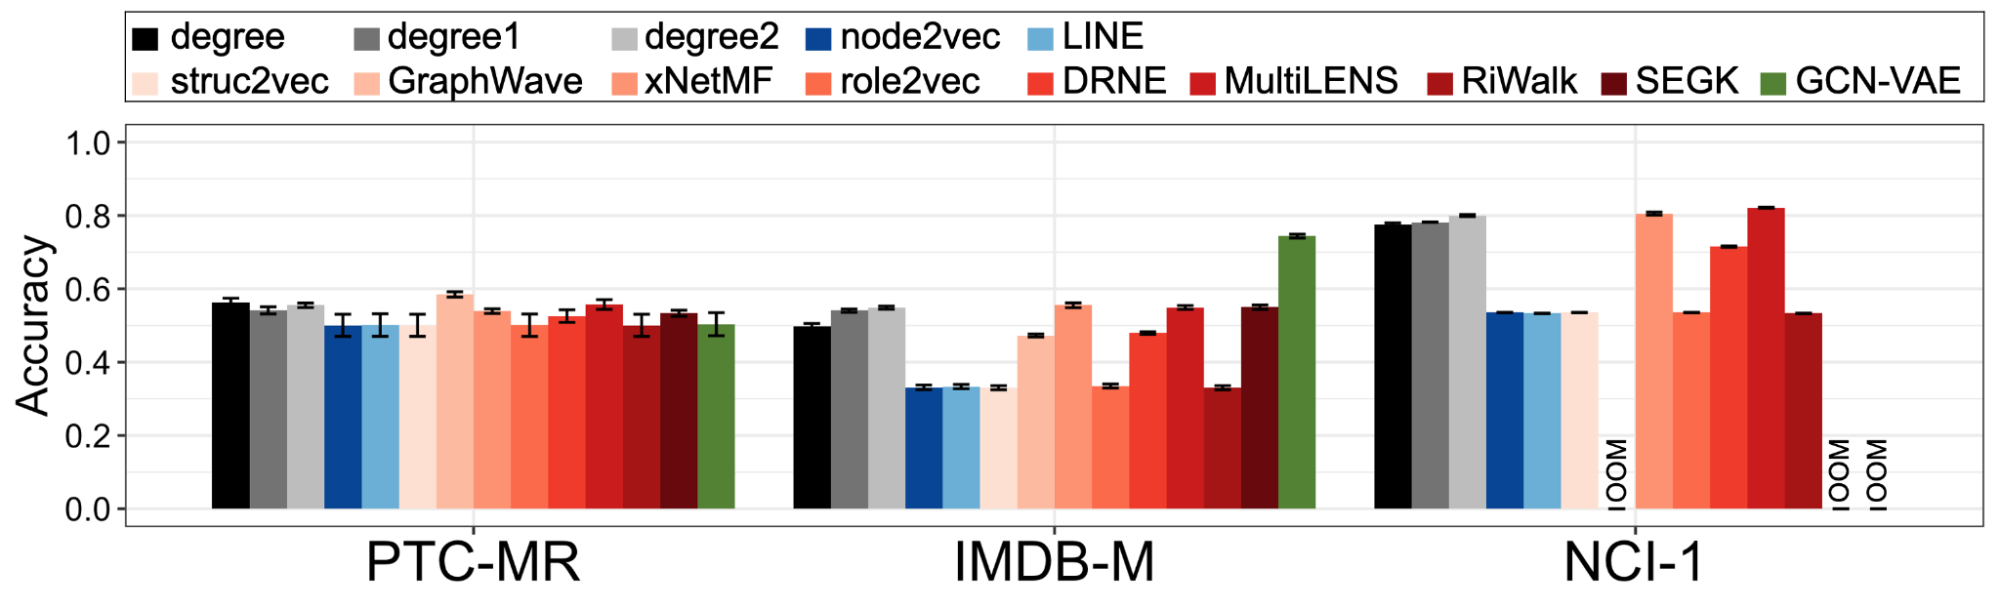
Graph Classification: Results
Observation: Best methods aggregate local connectivity (xNetMF, MultiLENS, SEGK, degree histogram)
Observation: Higher-order connectivity information slightly helps on larger datasets
[Jin, Heimann, Jin, Koutra. 2021. Toward Understanding and Evaluating Structural Node Embeddings. ACM TKDD 2021]
Notes:
We also gather real datasets of various sizes and make synthetic datasets with distinctive role equivalences of nodes to make a comprehensive empirical study.

Slide 73

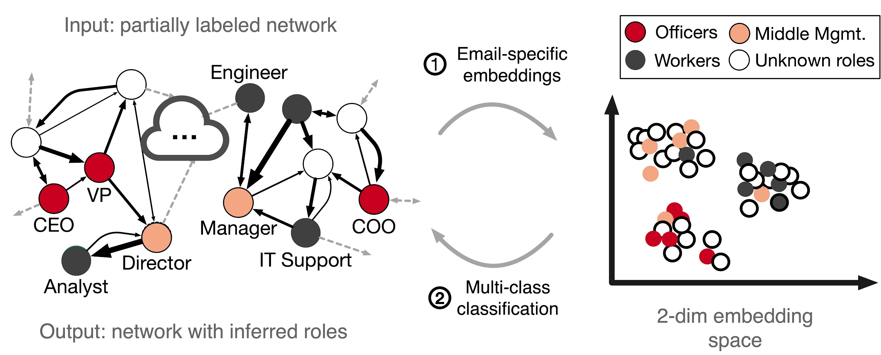
Application: Professional Role Discovery Across Companies from Email Behavior
Application
Hypothesis: professional roles of email users related to structural roles in email communication networks
Extend xNetMF embeddings to model:
Asymmetric communication of varying strengths
edge weights: weigh neighbors’ contributions to node’s identity
edge directions: count neighbors along incoming and outgoing edges separately
[Jin*, Heimann*, et al. KDD 2019]

Slide 74
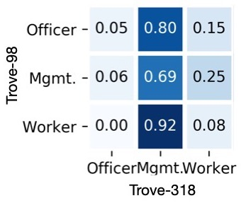
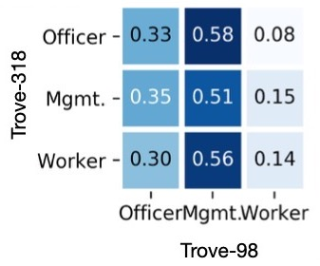
Comparing Roles Across Companies
Application
Observation: Most employees at small company (Trove-98) map to lower roles at big company (Trove-318)
Observation: Most employees at big company (Trove-318) map to higher roles at small company (Trove-98)
Explanation: For a given professional rank, employees at larger companies likely more connected
[Jin*, Heimann*, et al. KDD 2019]

Slide 75
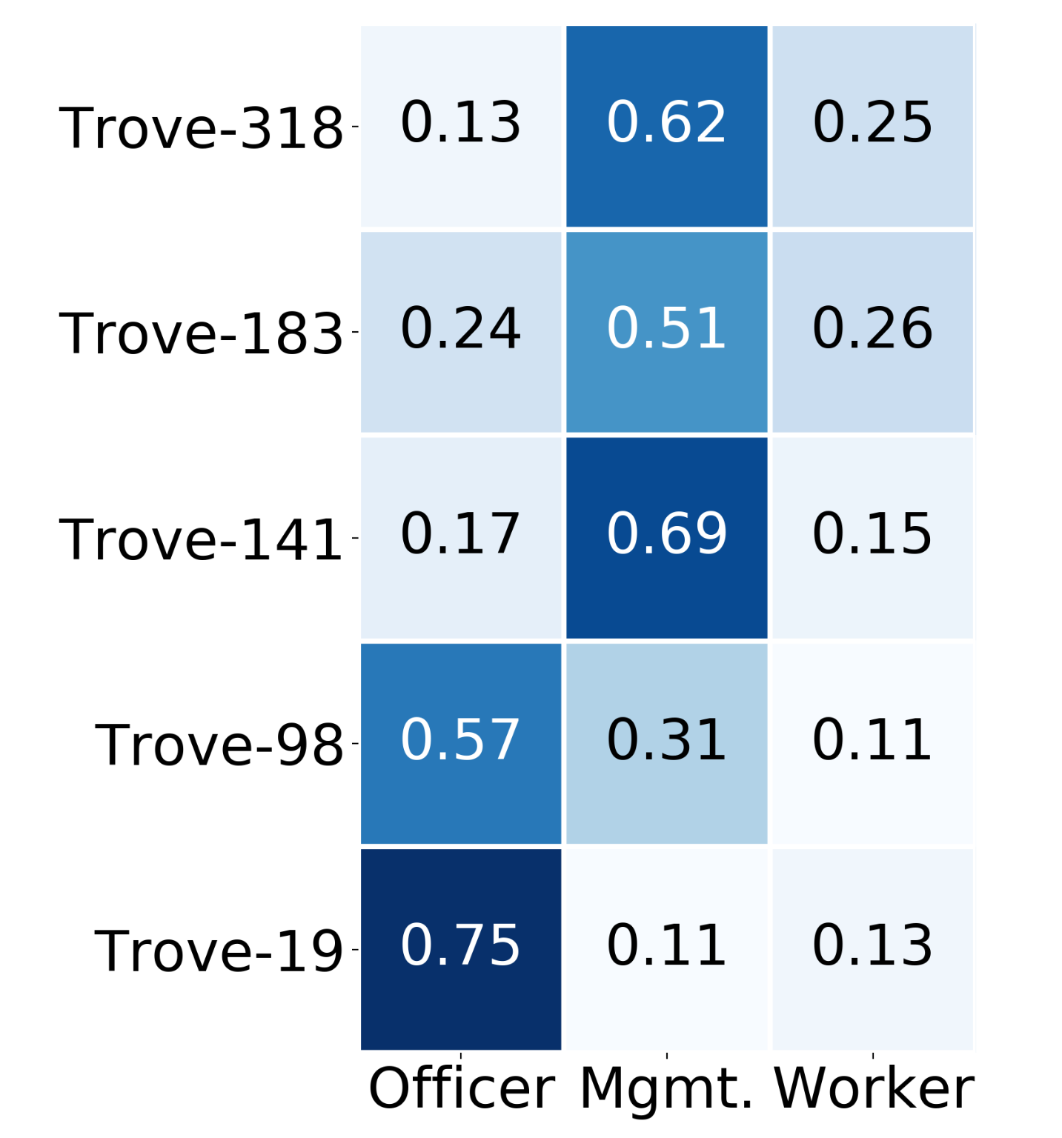
Academic vs Corporate Hierarchy: Profs
Application
Mapping Professors to Professional Roles
Comparing Graduate Students to Professional Roles
Observation: Professors behave like executives of small companies / managers of large ones
[Jin*, Heimann*, et al. KDD 2019]

Slide 76
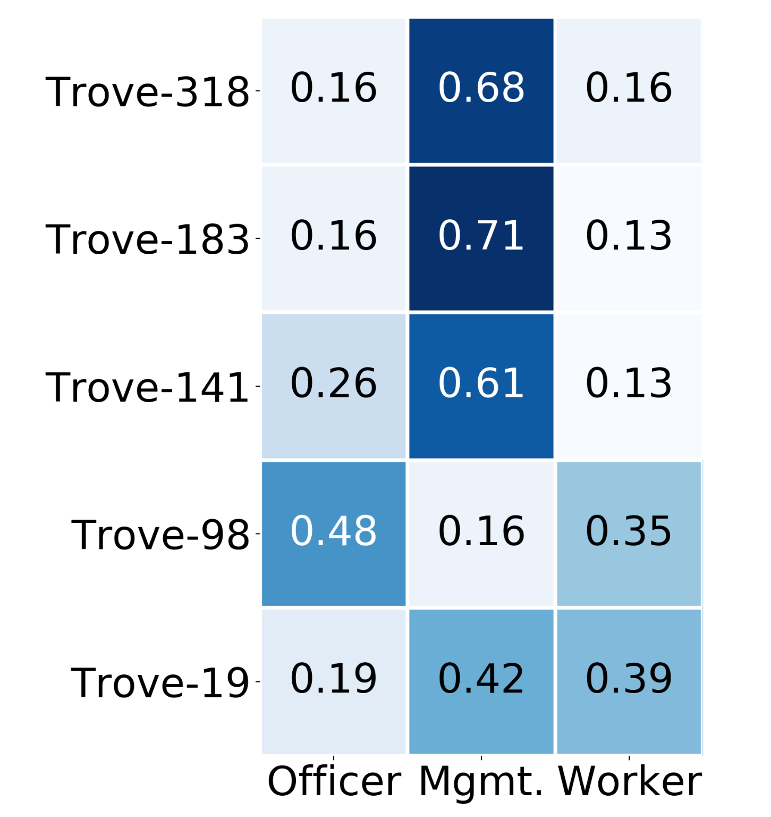
Academic vs Corporate Hierarchy: Students
Application
Mapping Grad Students to Professional Roles
Comparing Graduate Students to Professional Roles
Observation: Graduate students behave like managers/employees of other roles
[Jin*, Heimann*, Safavi+, KDD 2019]

Slide 77
Tutorial Outline:
Network Embedding for Role Discovery
Part I: Lecture
  Introduction
  Structural roles in
    network science
    mathematical sociology
  Structural or role-based embedding methods
  Mining structural roles within a network
  Mining structural roles across networks
Part II: Demo
  Hands-on demo

Slide 78
Part I: Take-away messages
Structural / role-based embeddings and equivalence types from sociology
Intrinsic and extrinsic evaluation of embeddings
  Structural equivalence best captured by proximity-based methods
  Structural embedding methods better capture automorphic and regular equivalence
  Degree variants can be building blocks for future methods
Comparison of structural embeddings for single and multi-network analysis
Notes:
Questions are welcomed!

Slide 79
Tutorial Outline:
Network Embedding for Role Discovery
Part I: Lecture
  Introduction
  Structural roles in
    network science
    mathematical sociology
  Structural or role-based embedding methods
  Mining structural roles within a network
  Mining structural roles across networks
Part II: Demo
  Hands-on demo

Slide 80

Hands On: Structural Embeddings Graph Library
https://github.com/GemsLab/StrucEmbedding-GraphLibrary

Slide 81
References: Structural Role-based Embeddings
Leonardo FR Ribeiro, Pedro HP Saverese, and Daniel R Figueiredo. struc2vec: Learning node representations from structural identity. In KDD, 2017.
Nesreen K. Ahmed, Ryan A. Rossi, John Boaz Lee, Theodore L. Willke, Rong Zhou, Xiangnan Kong, and Hoda Eldardiry. role2vec: Role-based network embeddings. In DLG KDD, 2019.
Claire Donnat, Marinka Zitnik, David Hallac, and Jure Leskovec. Learning structural node embeddings via diffusion wavelets. In KDD, 2018.
Aditya Grover and Jure Leskovec. node2vec: Scalable feature learning for networks. In KDD. ACM, 2016.
Mark Heimann, Haoming Shen, Tara Safavi, and Danai Koutra. Regal: Representation learning-based graph alignment. In 2018 ACM International Conference on Information and Knowledge Management (CIKM). ACM, 2018.
Di Jin, Ryan A Rossi, Eunyee Koh, Sungchul Kim, Anup Rao, and Danai Koutra. Latent network summarization: Bridging network embedding and summarization. In KDD, 2019.
Junchen Jin, Mark Heimann, Di Jin, and Danai Koutra. Towards understanding and evaluating structural node embeddings. In ACM Trans. Knowl. Discov. Data. ACM, 2021.
Giannis Nikolentzos and Michalis Vazirgiannis. Learning structural node representations using graph kernels. TKDE, 2019.
Ma Xuewei, Geng Qin, Zhiyang Qiu, Mingxin Zheng, and Zhe Wang. Riwalk: Fast structural node embedding via role identification. IEEE ICDM 2019.

Slide 82
References: Structural Role-based Embeddings
Jian Tang, Meng Qu, Mingzhe Wang, Ming Zhang, Jun Yan, and Qiaozhu Mei. LINE: Large-scale information network embedding. In WWW, 2015.
Aditya Grover and Jure Leskovec. node2vec: Scalable feature learning for networks. In KDD, 2016.
Thomas N Kipf and Max Welling. Variational graph auto-encoders. NIPS Workshop on Bayesian Deep Learning, 2016.
Ke Tu, Peng Cui, Xiao Wang, Philip S. Yu, and Wenwu Zhu. Deep recursive network embedding with regular equivalence. In KDD, pages 2357–2366, 2018.
Di Jin, Mark Heimann, Tara Safavi, Mengdi Wang, Wei Lee, Lindsay Snider, and Danai Koutra. Smart roles: Inferring professional roles in email networks. In KDD, 2019.
Mark Heimann, Tara Safavi, and Danai Koutra. Distribution of node embeddings as multiresolution features for graphs. In 2019 IEEE International Conference on Data Mining (ICDM). IEEE, 2019.
Ryan A. Rossi, Di Jin, Sungchul Kim, Nesreen K. Ahmed, Danai Koutra, and John Boaz Lee. On proximity and structural role-based embeddings in networks: Misconceptions, techniques, and applications. ACM Trans. Knowl. Discov. Data, 14(5):63:1–63:37, 2020.
Jing Zhu, Xingyu Lu, Mark Heimann, and Danai Koutra. Node proximity is all you need: Unified structural and positional node and graph embedding. In SDM, 2021.

Slide 83
References: Mathematical Sociology
•S.P. Borgatti and M.G. Everett. 1992. Notions of position in social network analysis. Sociological methodology22, 1 (1992)
•Stephen P Borgatti, Martin G Everett, and Jeffrey C Johnson. 2018. Analyzing social networks. Sage
•F. Lorrain and H.C. White. 1971. Structural equivalence of individuals in social networks. Journal of Mathematical Sociology
•S. Boorman, H.C. White: Social Structure from Multiple Networks: II. Role Structures. American Journal of Sociology, 81:1384-1446, 1976.
•R.S. Burt: Positions in Networks. Social Forces, 55:93-122, 1976.
•M.G. Everett, S. P. Borgatti: Regular Equivalence: General Theory. Journal of Mathematical Sociology, 19(1):29-52, 1994.
•K. Faust, A.K. Romney: Does Structure Find Structure? A critique of Burt's Use of Distance as a Measure of Structural Equivalence. Social Networks, 7:77-103, 1985.
•K. Faust, S. Wasserman: Blockmodels: Interpretation and Evaluation. Social Networks, 14:5–61. 1992.
•R.A. Hanneman, M. Riddle: Introduction to Social Network Methods. University of California, Riverside, 2005.
•L.D. Sailer: Structural Equivalence: Meaning and Definition, Computation, and Applications. Social Networks, 1:73-90, 1978.
•M.K. Sparrow: A Linear Algorithm for Computing Automorphic Equivalence Classes: The Numerical Signatures Approach. Social Networks, 15:151-170, 1993.
•S. Wasserman, K. Faust: Social Network Analysis: Methods and Applications. Cambridge University Press, 1994.
•H.C. White, S. A. Boorman, R. L. Breiger: Social Structure from Multiple Networks I. Blockmodels of Roles and Positions. American Journal of Sociology, 81:730-780, 1976.
•D.R. White, K. Reitz: Graph and Semi-Group Homomorphism on Networks and Relations. Social Networks, 5:143-234, 1983.
•…

